Slide 1
THE PERCEIVED EFFECTIVENESS OF ADVOCACY STRATEGIES

Slide 2
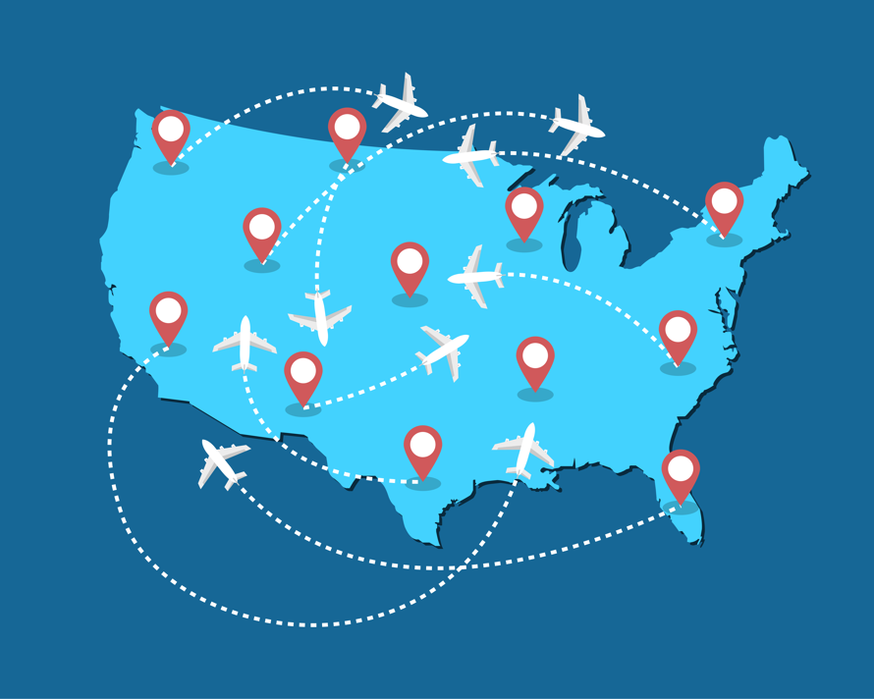
Study Overview
These findings and recommended actions are based on a nationwide study of tourism advocacy planning efforts.
In-depth interviews with 26 state-level destination and advocacy association leaders and an online survey with 205 local-level destination leaders were conducted.
Notes:
SPEAKER NOTES
The work shared here resulted from a study conducted by Dr. Ashley Schroeder and Dr. Whitney Knollenberg.
They conducted interviews with 26 state-level tourism leaders and an online survey with 205 local-level destination leaders to better understand how we can plan for advocacy efforts.
The emphasis of this work is on how we can effectively plan for advocacy efforts, not necessarily the outcomes of advocacy.
The findings presented today focus on the perceived effectiveness of advocacy strategies.

Slide 3
EVALUATING YOUR ADVOCACY STRATEGIES
Advocacy ensures that destination community stakeholders understand, prioritize, and support the value of tourism.
What strategies are you currently using to communicate the value of tourism?
How effective are these strategies in communicating the value of tourism?
Notes:
SPEAKER NOTES:
In the previous Actionable Advocacy Insights, we discussed the importance of the tourism industry using a unified definition of advocacy – communicating the value of tourism (this is the STORY) – and who will be doing the communication (this is the AUDIENCE).
The next step is to reflect on your current advocacy strategies and how effective they are in communicating the value of tourism.
Answering these two questions can help you identify which advocacy strategies to prioritize and identify gaps that could be addressed by adopting new strategies that your peers have found to be effective.

Slide 4
COMMON ADVOCACY STRATEGIES AT THE LOCAL LEVEL
The top 10 strategies that most local-level DMOs did to advocate for tourism in their community during the most recently completed financial year were:
Communicated with tourism industry partners
Attended community networking events as a tourism representative
Communicated with policy decision-makers
Communicated with leaders from other industries that impact tourism or are impacted by tourism
Staff involved in/served on boards and commissions
88.0%
100.0%
98.8%
98.2%
97.0%
97.0%
81.2%
Reported to decision-making bodies (e.g., City Council, County Commissioners, state level elected officials)
Used local media outlets to share content on the value of tourism
Shared content on the value of tourism through your social channels
Reported economic impact of tourism numbers for your community
Provided guest speaker(s) from your organization to talk at community events about the value of tourism
88.0%
54.2%
95.8%
95.2%
92.8%
92.8%
92.7%
81.2%
Notes:
SPEAKER NOTES:
An online survey with local-level destination leaders revealed common strategies that destinations used to communicate the value of tourism.
All local-level destination leaders indicated that their organization had communicated with tourism industry partners.
More than nine-in-ten local DMOs adopted the other top advocacy strategies during the most recently completed financial year.
The least commonly used advocacy strategies reveal two potential opportunities for local-level DMOs. The first is crafting legislation related to tourism – only 42.3% of local-level DMO leaders indicated that their organization did this to advocate for tourism in their community during the most recently completed financial year. The second is hosting an annual tourism day/week event – only 54.2% of local-level DMO leaders indicated that their organization had done this. However, some local-level destination leaders considered this to be one of the most effective advocacy strategies for their organization. If you are not already hosting an annual tourism day/week event, we encourage you to consider doing so.

Slide 5
How state-level tourism leaders implement effective advocacy Strategies
Two-way communication with tourism industry partners - advocates can identify key issues
Communicating with policy decision-makers - integrate diverse coalition members speaking with a unified voice
“One of the outcomes is to educate … residents on the value of tourism and the savings it brings households by way of tax savings and various other things. That's one. The second is looking at our local leaders as an audience to really educate them as far as the value and the return on investment that the investment destination marketing brings to any region if you do it the right way.” – State Tourism Office
“When we're in session … every Friday, we send all of our partners throughout [the state] our lobbyist's report for the week… Then people respond to us and say, ‘Well, let me tell you what has happened this week,’ or ‘Let me tell you what happened at our city council meeting.’ ” – State Tourism Advocacy Association
“The communication will come from different people, different organizations, a different sector, reinforcing the same thing.” – State Tourism Advocacy Association
Reporting to decision-making bodies - aligns with communicating the value of tourism to residents
Notes:
SPEAKER NOTES:
Interviews with 26 state-level tourism leaders illustrate what effective advocacy strategies look like.
Communication with partners should include opportunities for partners to share emerging issues and challenges, to make advocacy more proactive.
Communication with policy decision-makers must reflect the diversity of your coalition, which will strengthen the efforts to communicate the value of tourism, but they all need to be delivering the same message.
Reporting to decision-making bodies should make sense with efforts to communicate the value of tourism to residents.

Slide 6
PERCEIVED EFFECTIVENESS OF ADVOCACY AT THE LOCAL LEVEL
In general, local-level DMOs perceived their organization’s advocacy efforts to be effective in:
*Mean scores on a 7-point scale (where 1= not at all effective and 7= extremely effective)
Notes:
SPEAKER NOTES:
Local-level destination leaders were asked to indicate how effective they perceived their organization’s efforts to be.
In general, they perceived their organization’s advocacy efforts to be effective in 7 ways. They perceived that their organization’s advocacy efforts were most effective in establishing their organization as a valued source of tourism information among community leaders.

Slide 7

IT’S Time to Take action
Short-Term
Assess the effectiveness of current advocacy efforts – decide what to keep and where to improve.
Mid-Term
Connect with peer organizations and those in related industries to identify potential new advocacy efforts.
Long-Term
Implement one new advocacy effort and assess its effectiveness.
Notes:
SPEAKER NOTES:
Here is a “to do” list for us to identify how we can improve the effectiveness of our advocacy efforts.
We can take this short-term action to the next slide, where we will talk about our current and potential advocacy strategies.

Slide 8

CONVERSATION STARTERS
What advocacy strategies has your organization found to be the most effective?
What is one new advocacy strategy your organization could implement in the next year?
Who should lead the planning for implementing that advocacy strategy?
Notes:
SPEAKER NOTES:
These topics of conversation are designed to help us start implementing our “advocacy planning to do list” (strategies on the previous slide).
Let’s take a few minutes to talk through each of these.

Slide 9



ABOUT THE National advocacy study
Purpose: To identify best practices in advocacy planning among tourism industry organizations.
Goal: To advance knowledge of tourism advocacy planning.
Overview: This study provides insights into the competencies, practices, and resources of tourism organization leaders who engage in advocacy.
Methods:
Interview and survey data were collected from 2019 - 2021 to inform this Actionable Advocacy Insights series.
26 in-depth phone interviews with state-level destination and advocacy association leaders.
205 online survey responses from local-level destination leaders.

Slide 10
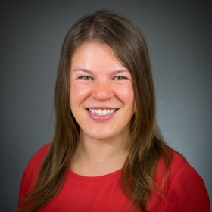
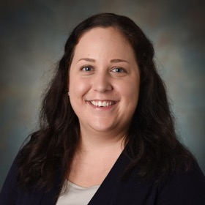


Contact us
Whitney Knollenberg, Ph.D.
Associate Professor
Department of Parks, Recreation, and Tourism Management
North Carolina State University
wgknolle@ncsu.edu
Ashley Schroeder, Ph.D.
Research Lead
Richardson Family SmartState Center for Economic Excellence in Tourism
Assistant Professor
School of Hotel, Restaurant, and Tourism Management
University of South Carolina
as232@mailbox.sc.edu
Department of Parks, Recreation and Tourism Management

Slide 11
acknowledgements
In addition to the study participants, we would like to give special thanks to the following individuals and organizations for their support of this research: Hailey Post, Ann Savage, Shannon Stover, Dr. Mandi Stewart, Southeast Tourism Society, Travel and Tourism Research Association, and American Society of Association Executives.

